Slide 1
Digital portfolio
STUDENT NAME: J.RAJASHREE
REGISTER NO AND NMID:212404646 AND F1C786119195065BFFC4BF837838079D
DEPARTMENT: BCA
COLLEGE: R.B GOTHI JAIN COLLEGE FOR WOMEN
(Affiliated to the University of Madras)

Slide 2
PROJECT TITLE:
My digital
Portfolio
Showcasing my
Journey to
Crafting my carrer
path

Slide 3


AGENDA
Problem Statement
Project Overview
End Users
Tools and Technologies
Portfolio design and Layout
Features and Functionality
Results and Screenshots
Conclusion
Git hub Link
3/21/2024 Annual Review

Slide 4

PROBLEM STATEMENT
Student often struggle to showcase their skills, projects, and achievments in a structured way. A digitl portfolio solves this by providing a personalized platform for presenting one’s academic and technical journey

Slide 5

PROJECT OVERVIEW
Brief summary of your project.
What your portfolio contains(About me, project1,project2,project3,skills,contant).
Main idea: showcase personal achievement ,skills ,and project

Slide 6

WHO ARE THE END USERS?
Students (academic projects, resumes).
Job seekers (to show with recruiters).
Freelancers (to show clients).
Professionals (to highlight experience and achievements).

Slide 7

TOOLS AND TECHNIQUES
CSS→ Styling ( colors, layout, responsiveness).
HTML→ Structure(pages, sections).
JavaScript→ Interactive (navigation menu, animations, from validation).
Mention code editor(VS Code)or CODEPEN and hosting platform (git Hub Pages).

Slide 8
POTFOLIO DESIGN AND LAYOUT
Sections included:
Home/About Me
Projects
Skills
Contact
Responsive layout(mobile + desktop view).
8

Slide 9
FEATURES AND FUNCTIONALITY
Navigation bar with smooth scrolling.
Project showcase with images/details.
Interactive elements(hover effects, animations).
Content form(with validation).
Responsive design for all devices.

Slide 10
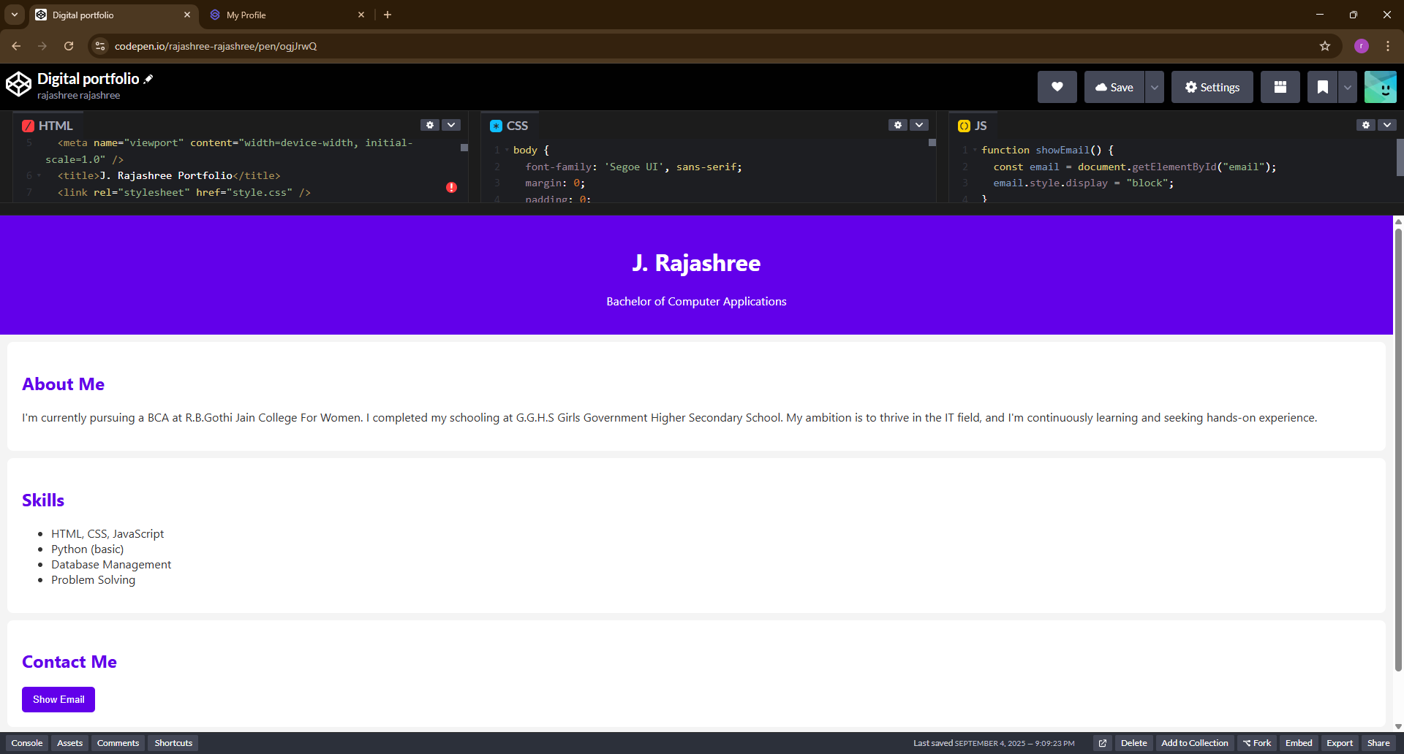

RESULTS AND SCREENSHOTS
3/21/2024 Annual Review
10

Slide 11
CONCLUSION
In conclusion, this digital portfolio serves as a personalized platform to present my academic background , technical skills, and career aspirations. It no only highlights my project and achievement but also reflect my creativity and passion for web development. This project helped me enhance my knowledge of HTML,CSS,and JavaScript while creating a responsive and user-friendly website
11

